Slide 1
To start learning RFT
Niklas Törneke

Slide 2
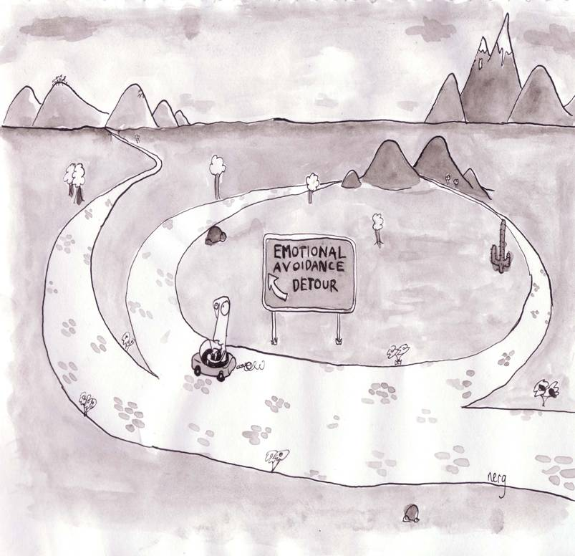

Slide 3
The structure of the presentation
Basic assumptions: Functional contextualism
Basic understanding of relational frame theory
Basic clinical implications

Slide 4
Functional contextualism
CONTEXT
CONTEXT

Slide 5
Respondent
Unconditioned stimulus (US) Unconditioned response (UR)
Conditioned stimulus (CS) Conditioned response (CR)
Operant
Antecedent Behavior
Consequence

Slide 6
RFT; one central idea
Human languaging and cognition consists of a specific kind of learned behavior:
A particular way of relating stimuli

Slide 7
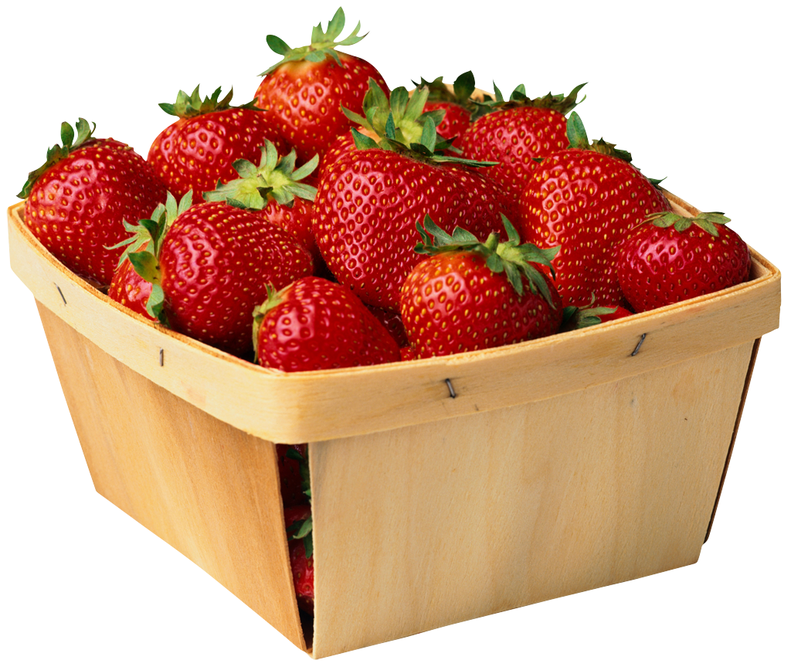

Relating controlled by the phenomena related

Slide 8
Relating controlled by arbitrary contextual cues
Humans teach their offspring to abstract arbitrary stimuli (sounds, words, gestures) to control relations and thereby transform stimulus function
is more than
is the same as
is the same as a hard punch on the nose
is the same as 10000 $

Slide 9
Relating controlled by arbitrary contextual cues
LESS THAN
MORE THAN

Slide 10
Different relations
IN FRONT OF
AFTER
BEFORE
BEHIND

Slide 11
Different relations
Coordination (the same as)
Comparison (more-less)
Opposite
Hierarchical relations (part of)
Spatial relations (in front of-behind)
Temporal relations (before-after)
Conditional relations (if-then)
Perspective/deictics (here-there)

Slide 12
This particular kind of relating is called:
Arbitrarily applicable relational responding
Derived relational responding
Relational framing

Slide 13
An exercise
In what way is…
One list Another list
1. 1. behind 1. ?
2. 2. longer than 2. ?
3. 3. before 3. ?
4. 4. better than 4 ?.
5. 5. inside 5. ?
6. 6. same as 6. ?
7. 7. part of 7. ?

Slide 14
The effects of relational framing
For a human being anything in the context can obtain functions due to how it is related to other phenomena by this repertoire
The very behavior of humans (even private, subtle behavior) can obtain functions due to how it is related to other phenomena by this repertoire
The technical term for this is transformation of functions
Two areas of special importance: The ability to follow instructions (rule following) Interaction with your own behavior (self)

Slide 15
Rule following
Rules specify what to do and for what
“Turn left at the next traffic light, drive one kilometer and take first right
after the petrol station and then you will see the football arena straight ahead”
“Make sure you sleep, otherwise you will be ill”
“If you go to bed now you will have a surprise tomorrow”
“If you do that again I will go away and never come back”
“Find out why you are anxious and the anxiety will go away”
All is changed when stimuli (part of the context) can acquire function (effect on behavior) in a new way!
CONTEXT
A
C
CONTEXT

Slide 16
The “self”
CONTEXT
Training to interact with your own behavior
In simple words:
I learn that I am “I” and that my own subtle responses, such as thinking and feeling, are part of but not identical to “I”
In technical words:
I learn to frame my own responses in perspective from and in hierarchy with a deictic I
Self as ongoing process
Self as story, content or concept
Self as perspective or context
Training in deictic framing of your own responses
I – HERE – NOW versus I – THERE – THEN
As a result we have the “fromeness” of human experience: a particular experience of perspective which is a result of the ability to interact with arbitrary contextual cues (we experience a “deictic I”)
CONTEXT
16
Törneke

Slide 17
Two ways of responding to your own responding
In hierarchy
with deictic I
In coordination
NOW

Slide 18
“A person who has been “made aware of himself” by the questions he has been asked is in a better position to predict and control his own behavior” (Skinner, 1974, p. 35).

Slide 19
The risks of relational framing
To sum it up:
Your own verbal behavior can trick
you into doing things that will not
work well for you!
The interface with pain will increase enormously
Following instructions: direct experience can be overruled
The risk of getting stuck in vicious circles when following instructions

Slide 20
Psychological treatment informed by relational frame theory:
ACT

Slide 21
Two ways of responding to your own responding
In hierarchy
with deictic I
In coordination
NOW

Slide 22

Flexibility
In hierarchy
with deictic I
In coordination
Rigidity
NOW

Slide 23
Central task: discriminate these two strategies!

Slide 24
Flexibility:
Psychological flexibility is the ability to interact with your own
reactions (thoughts, sensations, feelings, memories) in a way that
helps you to take action towards what is important to you.
A key repertoire in this is the ability to frame your own responses
in hierarchy with a deictic I
Why is this essential?
Because that will increase the probability
for other contextual factors to influence further behavior.
You will be ”more open to the rest of what goes on”,
including other aspects of your own responding
Notes:
Exemplify: “I can not do this”

Slide 25
Rigidity:
Fusion
Experiential avoidance
Fusion: The pattern of not distinguishing, in the moment, “I” from subtle/private self–instructions (your own responses)
Experiential avoidance: The pattern of following self–instructions to control, extinguish or lessen private responses such as feelings, thoughts, memories and bodily sensations

Slide 26
Three clinical tasks
Help the patient discern the relationship between what he does in crucial situations and the problematic consequences he experiences (functional analysis, A – B – C analysis, creative hopelesness)
Help the client discern his own feelings, thoughts, memories and bodily sensations by establishing a distance of observation to them as they emerge (defusion)
Help the client use this skill to clarify what is important in his life and to specify what would be concrete steps in that direction (valuing) Reference: Törneke, Luciano, Barnes–Holmes & Bond (2016) RFT for clinical practice: Three core strategies in understanding and treating human suffering. In Zettle, Hayes, Bigland & Barnes–Holmes (ed) Wiley Handbbok of Contextual Behavioral Science (p. 254–272)

